Slide 2
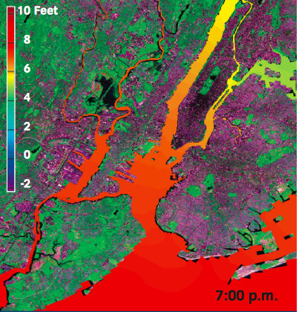
Sandy and Its Impacts
…More than 400 New York City Housing Authority buildings containing approximately 35,000 housing units lost power, heat, or hot water during Sandy…
http://www.nyc.gov/html/sirr/downloads/pdf/final_report/Ch_1_SandyImpacts_FINAL_singles.pdf

Slide 4
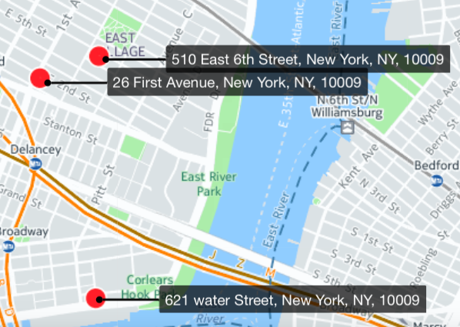
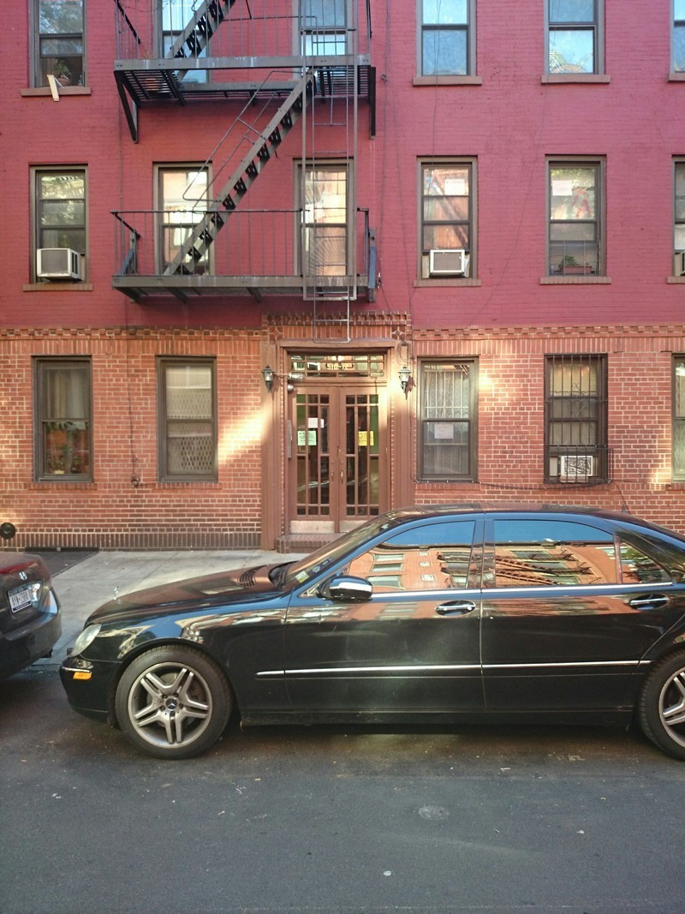
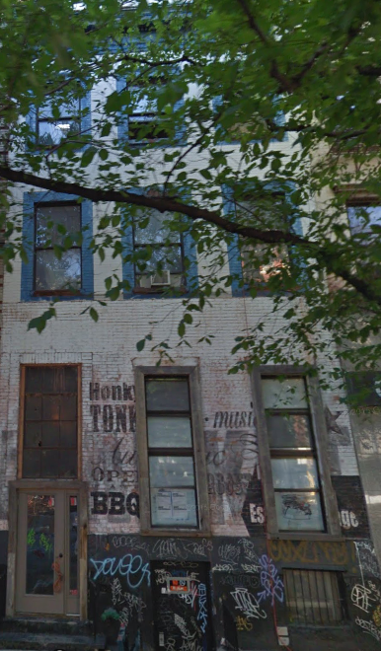
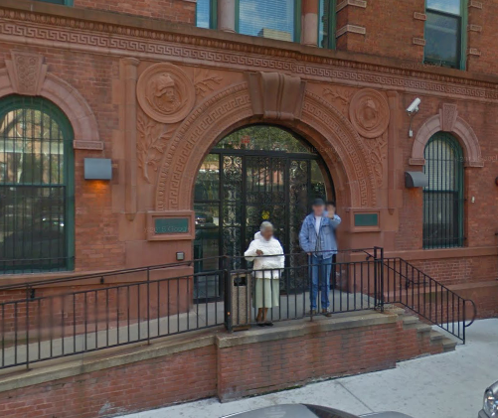
<TOP 3 Repeat caller >
510 E 6th Street(238 complains) 20 Units | 5 Stories | Built in 1900
26 1st Avenue (190complains) 20 Units 6 Stories Built in 1920
621 WATER STREET(156)
124 units 5 stories Built in 1901

